Slide 1

Bacterial Growth
2nd Year – 1st semester
Dr. Munira Ch. Ismail

Slide 2
Learning Objectives
Bacterial growth
Growth requirements
-Major Nutrient requirements
-Growth factors
-Physical requirements
Phases of growth
-Lag Phase
-Log Phase
-Stationary Phase
-Death Phase

Slide 3
1. Bacterial Growth
“generation time” describe the growth rate.
is the time required for the population to double.
maxim time varies for various organisms.
-as short as 20 minutes (E. coli) for some rapidly growing pathogens
-as long as 20 hours (Mycobacterium tuberculosis).
Many pathogens: less than 30 minutes, thus their populations can quickly become very large.
One bacterium with a 30 min generation time will grow overnight (12 hrs) into more than one billion cells. After less than three days of exponential growth (with an unlimited supply of nutrients), this culture would weigh as much as planet earth!

Slide 4
Factors affect the growth rate
Exhausted nutrient supplies or key resources
Accumulation of toxic metabolic products
Antibiotics from neighboring microbes (or humans)
Immune system
Environmental conditions

Slide 5
2. Growth Requirements
Major Nutrient Requirements
Carbon: (make all molecules)
Nitrogen: (protein and DNA synthesis)
Phosphorus: (membrane phospholipids and DNA)
Sulfur: (protein synthesis)
Iron: (enzymes >>>metabolism)
Growth factors
Physical requirements

Slide 6
Major Nutrient Sources
Glucose
Other sugars
Proteins, peptides, and amino acids
Lipids
Organic acids
Alcohols

Slide 7
Carbon: Important points
Many nutrient sources serve as both an energy source and a source of carbon for the synthesis of all cellular components. Ex. in the presence of O2 many bacteria can oxidize about 50% of the glucose to CO2 and water, and this produces enough energy to convert the remaining 50% of the glucose to cell material.
Many bacteria can also use a wide variety of organic compounds (amino acids, DNA, lipids, other sugars), depending upon what degradative enzymes they have.
The carbon sources that a bacterium use can be diagnostic (Autotrophs and Heterotrophs)
Amino acids peptides and proteins are excellent sources of C, N, and S.

Slide 8
Nitrogen: Important points
Bacteria need large amounts of nitrogen to synthesize proteins and nucleic acids.
Many pathogenic bacteria require specific, pre-formed amino acids.
Amino acids and peptides can be taken up by bacteria.
Proteins (too big). Thus, many pathogens secrete proteases.
Ammonia (NH4+) and nitrate are also possible nitrogen sources.
Microbes secrete nucleases to break down available DNA and RNA.
Microbes can take up nucleotides that can be used as C, N, and P sources, or for their own nucleic acid synthesis.

Slide 9
Phosphorus: Important points
Microbes may produces phospholipases that act on host cell membranes or lung surfactant.
Degradation of phospholipids from host cell membranes provides microbes with C, N, P
Low phosphorus or low iron levels can induce phospholipase production.
Host cell lysis by phospholipase activity yields iron

Slide 10
Iron: Important points
Iron (Fe) plays an important role in host-pathogen relationships.
The host makes iron binding factors that make iron unavailable to microbial invaders.
Bacteria and fungi make iron chelators (siderophores) that can extract iron from host reserves.

Slide 11
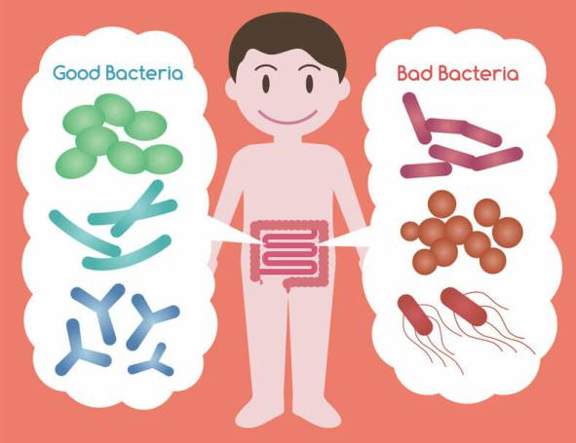
Differentiation
Pathogenic bacteria: pathogenesis often results from microbes accessing host nutrients.
Microflora organisms (Normal flora: are “provided for” by the host.

Slide 12
B. Growth Factors
Organic compounds that are required by microorganisms in small amounts which the cell can not synthesize from other carbon source.
These are aminoacids, purines and pyrimidines, and vitamins.
While E. coli needs no growth factors and can grow on glucose, NH4+, and inorganic ions, many host associated microbes require one or more specific growth factors in addition to the carbon source.
Different organisms require different growth factors. Some are “fastidious”.
The requirement for growth factors can be diagnostic (Prototrophs, Auxotrophs)

Slide 13
C. Physical requirements
Temperature
PH
Osmotic Conditions

Slide 14
Temperature
For each organism there is an optimal temperature for growth and a range of temperatures at which growth will occur.
Most pathogens usually grow best at 37°C, body temperature.
Environmental bacteria often (grow better at room temperature (22 to 30°C)
Some bacteria (Legionella) are capable of growing at high temperatures (near 45°C).
good refrigerator (below 4°C)will prevent growth of most pathogens.
However, Listeria a causative agent of food poisoning, can grow at or below 4°C.
Diagnostic: Psychrophilic , Mesophilic ,Thermophilic

Slide 15
PH
PH affects the growth rate of bacteria: There is a range and an optimum for each species.
For pathogens, this is usually pH 6.0 to 8.0, with an optimum at(7.4).
Clostridium botulinum (which produces the botulinum toxin that causes botulism) is more of a problem in canned foods with less acidity.
Dignostic: Neutrophilic, Acidicophilic , Alkalinophilic

Slide 16
Osmotic Conditions
Very high salt concentrations inhibit growth of many pathogens.
Most bacteria do not need to regulate their internal osmolarity with precision because they are enclosed by a cell wall capable of withstanding a considerable internal osmotic pressure.
Contrast this to the red blood cell, which will burst if placed in distilled water, and must be maintained in physiological saline (0.85% NaCl).
The osmotic strength of a medium can be adjusted by addition of ions such as NaCl or non-metabolized sugars such as sucrose.
Diagnostic: Halophilic, Moderate halophiles, Extreme halophiles

Slide 17
Home Work 2
+Define the following terms
Autotrophs and Heterotrophs
Prototrophs, Auxotrophs
Psychrophilic , Mesophilic ,Thermophilic
Halophilic, Moderate halophiles, Extreme halophiles

Slide 18


